Slide 1
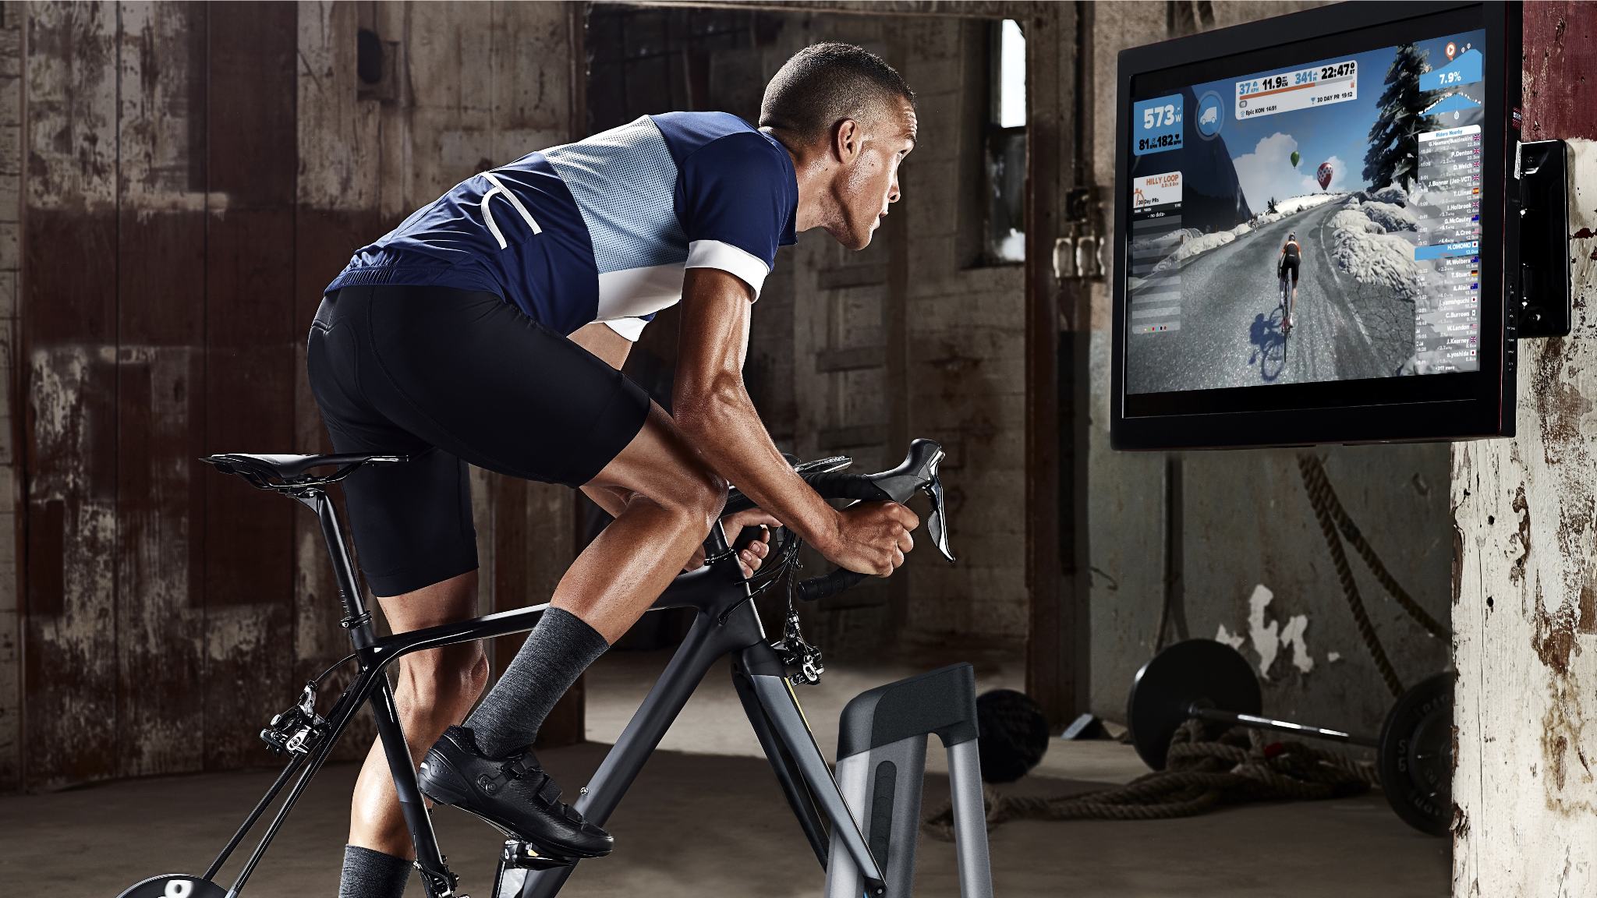

Homework 1
Wahoo Fitness: Segmentation and Data Insights
Anna Khairi
Logan Roach
Mark Stiles
Oliver Gunn
Sachi Singh
Marketing Analytics - IST 653
October 16, 2023
Notes:
Oliver

Slide 2

Executive Summary
We analyzed customer data from Wahoo Fitness to glean marketing analytics insights
Our analysis identified 3 distinct customer segments for consideration
Segment 1: Athletic for Pure Pleasure – (“past-time-ers”)
Segment 2: Health- & Sports-focused – (“health conscious”)
Segment 3: Pure Competition – (“athletic lifestyle”)
New Products & Features
Social Media – shareable workouts, workout leaderboards between global users & friends
Nutrition Tracking – integrations with other companies (B2B engagement)
Product Warranties / Insurance
Product Customization – watch faces & bands, custom colors, sports franchise partnerships
Growth Strategies
Higher subscription volume – upcycling free app users to paid subscribers
App Advertising – Paid search & In-app ads
Repeat purchase incentives
Product line expansion
Software opportunity – enhancing app ecosystem to create universal Wahoo Health dashboard
Notes:
Oliver

Slide 3
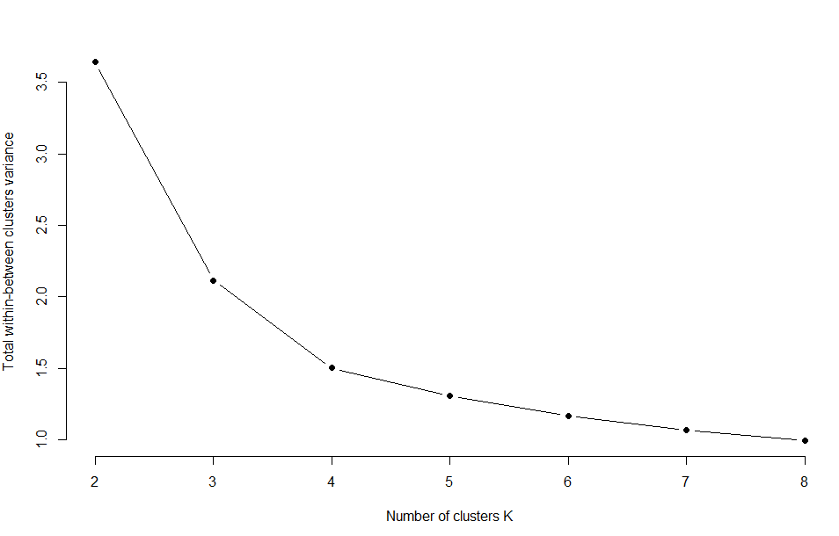
CLUSTERS
Optimal Cluster
Notes:
Logan
Developing an elbow plot with the data provided showed that three clusters provided value but a fourth cluster may also have provided additional value. We used the 3 clusters that were determined for us throughout the rest of the analysis but found it interesting to note.

Slide 4
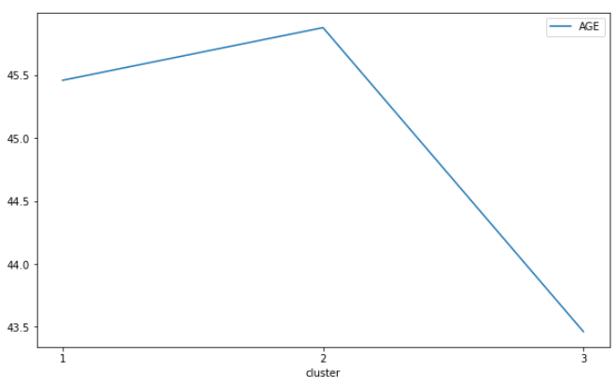
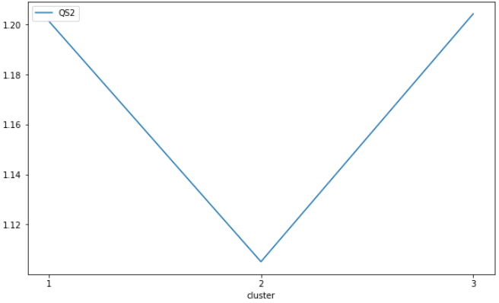
DEMOGRAPHICS
Age
Gender
Segment 1 and 2 have similar ages with Segment 3 slightly younger
Segment 2 has slightly higher rate of men but all have more men than women
Notes:
Logan
Taking a look at the age distributions, there’s likely a big opportunity for outreach to the 20-35 age range that could be future customers. They’re not engaged in large numbers and should be considered for early outreach if the prime customer age is roughly 45. Preparing them to join early could improve overall customer lifetime value.
The segments did vary by age and gender but not enough that it would be a determining factor in segmentation outreach. The ages for segment 1 and 2 were within a half a year of each other where segment 3 was around 2 years younger. Enough to say that a slightly younger age band was more active and focused on performance but not such a difference in age that it would logically make sense to target that age. Their age could indicate they have more disposable income. It could also mean there’s room to grow in the 20’s age range.
Gender was similar in that the difference between each group wasn’t leaning heavily toward one gender or another but all groups did lean slightly more toward 1 (men) than 2 (women).

Slide 5
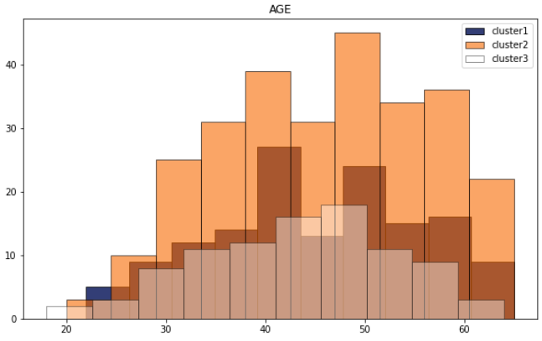
DEMOGRAPHICS
Similar age range
Cluster 2 more uniform
20-35 low engagement
Reach 20-35 earlier
Notes:
Logan
Taking a look at the age distributions, there’s likely a big opportunity for outreach to the 20-35 age range that could be future customers. They’re not engaged in large numbers and should be considered for early outreach if the prime customer age is roughly 45. Preparing them to join early could improve overall customer lifetime value

Slide 6
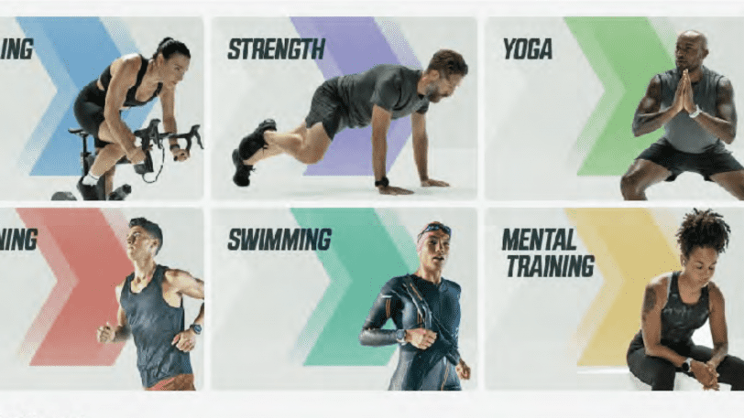
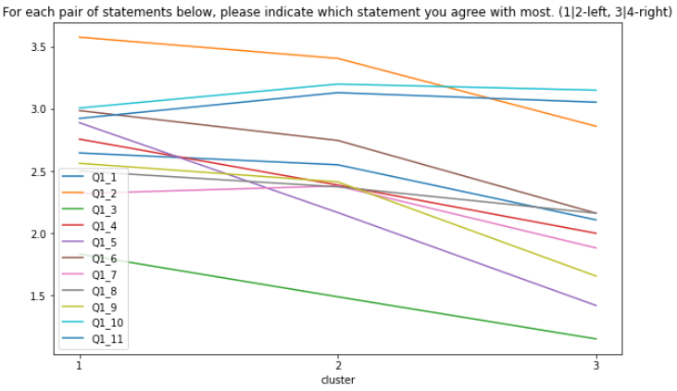
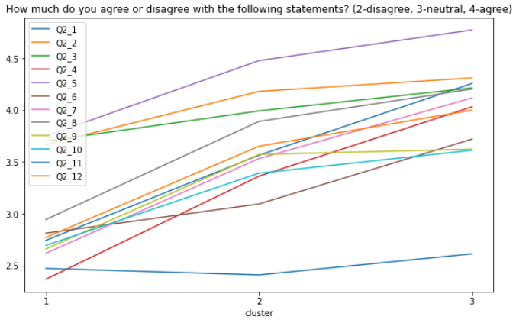
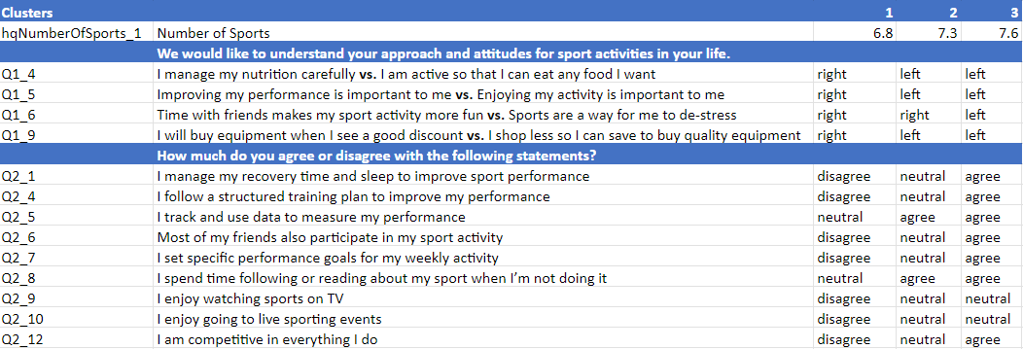
PSYCHOGRAPHICS
Health focused vs relaxed
Health committed vs. aspirant
Largest Value Differences
Notes:
Mark
The first segment identified was not as interested in metrics driven performance as the other segments but with a higher focus on enjoyment and social engagement. They were also willing to spend more for a product they liked.
The second segment was in between the other two segments with a stronger lean towards performance but interest in enjoyment. There were less specific with their goals but were engaged in tracking and following sporting events.
Segment 3 focused more on nutrition, performance and competitions. They would be more likely to purchase used or discounted products. They were more interested in maximizing the use of a product.
The graphs show a visual representation of the answers above with visible differences between the clusters for most of the answers. They had a similar trajectory which confirms the result of the table.

Slide 7
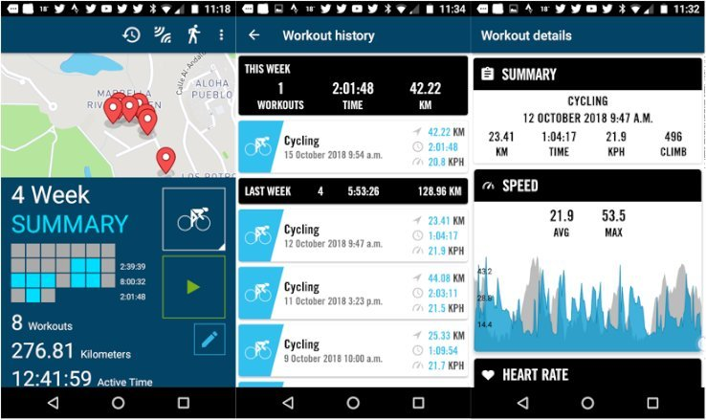
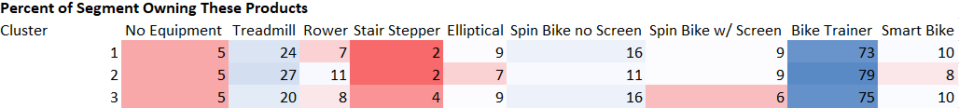
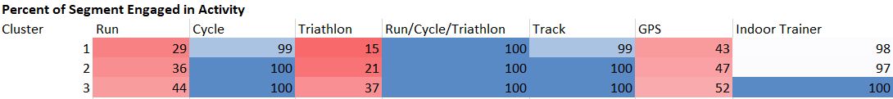
PASSIONS
Product Used
Product Owned
Activities
Notes:
Mark
All segments had similar exercise products. High percentages of all segments used the bike trainer and treadmill. There were noticeable levels of use for the rower, spin bike with or without screens, rowers, ellipticals, or smart bikes. No segment used the stair steppers in significant numbers. Overall all groups were heavy users of running or biking equipment. There wasn’t much difference between the segments except for treadmill usage. Segment 2 did use the treadmill and rower at the highest rate but still within a narrow range of difference.
Similar to the previous question, cycling, track running, all activities together and using an indoor trainer had consistently high levels in all segments. Running, triathlons and GPS use was significant but had gradations between the segments. Segment 1 had the least use of those and segment 3 had the highest which is consistent with the other findings that segments 3 had a higher commitment to competition and performance.

Slide 8
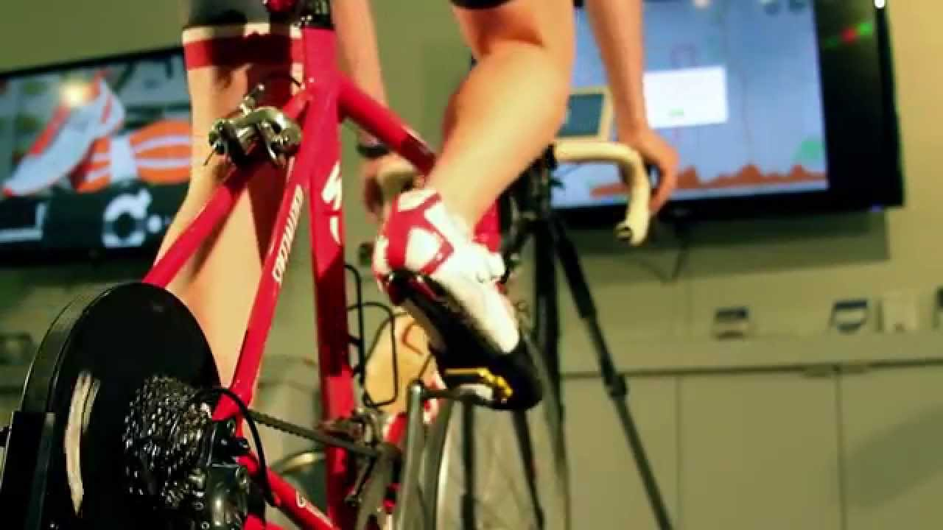
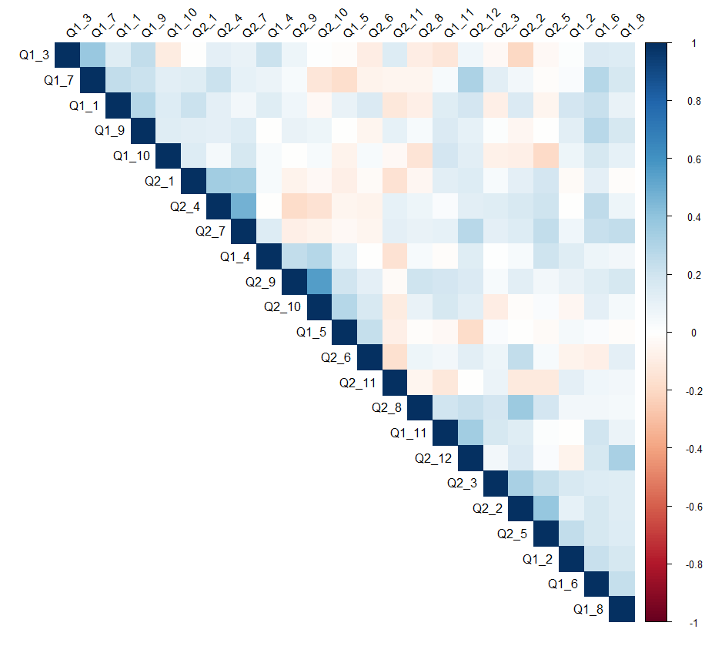
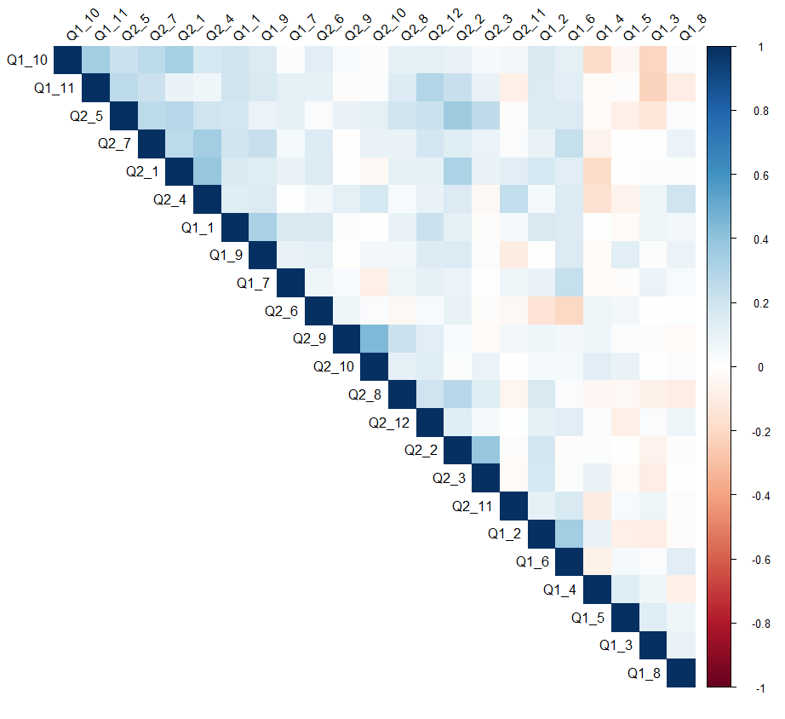
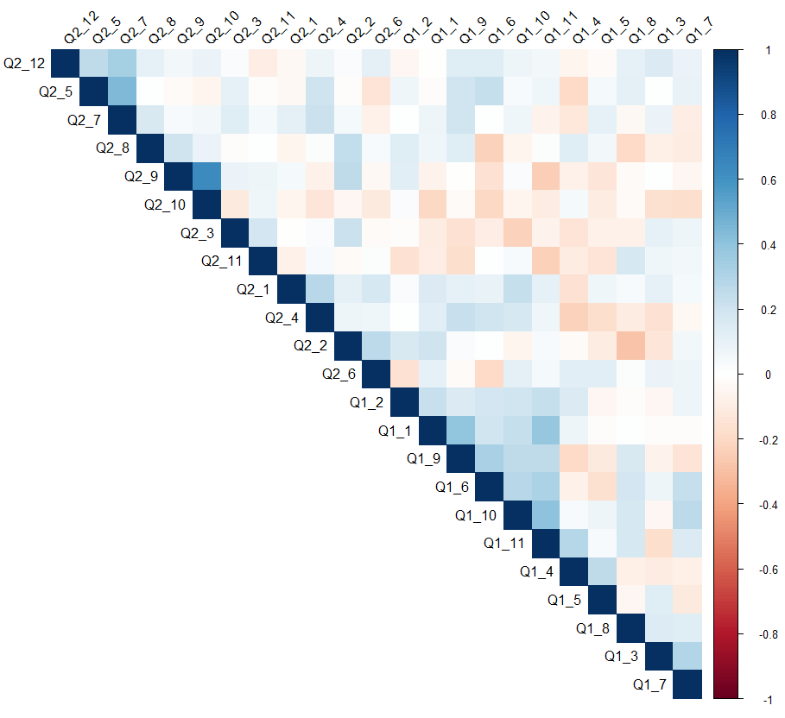
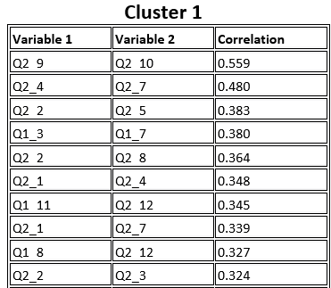
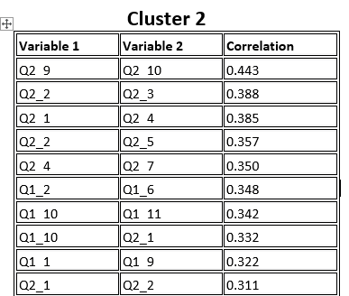
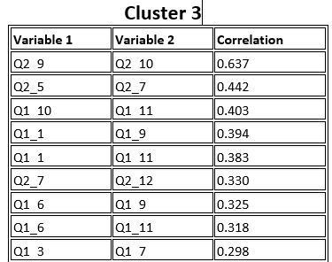
Insights from Each Segment (Q1s & Q2s)
Cluster 1 :
Q2_9 (Enjoy watching sports on TV) & Q2_10 (Enjoy going to live sporting events): Correlation 0.559
Q2_4 (Follow a structured training plan) & Q2_7 (Set specific performance goals): Correlation 0.480
Cluster 2 :
Q2_9 (Enjoy watching sports on TV) & Q2_10 (Enjoy going to live sporting events): Correlation 0.443
Q2_2 (Knowledge about sporting equipment) & Q2_3 (Maintain own sporting equipment): Correlation 0.388
Cluster 3 :
Q2_9 (Enjoy watching sports on TV) & Q2_10 (Enjoy going to live sporting events): Correlation 0.637
Q2_5 (Track and use data to measure performance) & Q2_7 (Set specific performance goals): Correlation 0.442
Notes:
Sachi
Reading through the r code i noticed that data was segmented from mean of Q 1-1 to Q 2-12 (57-79), by noticing that i
Drill down on each segment utilizing the pre existing r code.
Additionally i utilizing get_top_correlations, create_coor_heatmap, cor functions, coorplot, and sorting in R. The
top 20 positive correlations within each cluster were produced along with a heat map. This is an
important step to figure out what is really going on within each cluster and to understand the difference
amongst each cluster. By utilizing cluster specific insights marketing campaigns can super specific
towards each cluster to maintain a healthy retention rate.
Cluster 1 Q2_9 (Enjoy watching sports on TV) & Q2_10 (Enjoy going to live sporting events): Correlation
0.559 People who enjoy watching sports on TV are also likely to enjoy attending live sporting events.
Q2_4 (Follow a structured training plan) & Q2_7 (Set specific performance goals): Correlation 0.480
Those who follow a structured training plan tend to also set specific performance goals suggesting a
more disciplined approach to their sport or activity. Q2_2 (Knowledge about sporting equipment) &
Q2_5 (Track and use data to measure performance): Correlation 0.383 Individuals knowledgeable about
their sporting equipment also tend to track and use data to measure their performance indicating a
technical and informed approach to their sport or activity.
Cluster 2 Q2_9 (Enjoy watching sports on TV) & Q2_10 (Enjoy going to live sporting events): Correlation
0.443 Similar to Cluster 1, individuals enjoying watching sports on TV also tend to enjoy attending live
sporting events, but the correlation is slightly less strong in this cluster. Q2_2 (Knowledge about sporting
equipment) & Q2_3 (Maintain own sporting equipment): Correlation 0.388 People who know a lot about
their sporting equipment also tend to maintain their own equipment indicating a hands-on approach
and deep engagement with their sport or activity.
Cluster 3 Q2_9 (Enjoy watching sports on TV) & Q2_10 (Enjoy going to live sporting events): Correlation
0.637 This correlation is the strongest across all clusters, enjoyment of watching sports on TV and
attending live events goes hand in hand. Q2_5 (Track and use data to measure performance) & Q2_7 (Set
specific performance goals): Correlation 0.442

Slide 9

RECOMMENDATIONS
PAST TIME & STRUCTURED PLAN:
Partner with sports teams for discounts
Blogs or videos on creating training plans
Foster a community where they can talk about sports
HEALTH CONSCIOUS & HANDS ON:
More entertainment, Sports Channels
Social perks
Food Recommendations
Provide tips on how to maintain sport equipment
LIFESTYLE & DATA DRIVEN:
Discounts, Especially on data drive tech like fitness watches
Product Feedback Portal
Community MVP program
Newsletter / Event Reminders
Social Perks
Streaming Content
Recap Races
Special Tracks to Train On
Personal Goal Recap
Notes:
Anna
Based on what we’ve learned from the Wahoo Fitness Article and our customer feedback.. For our Past Time and structured customers, let’s collaborate with sports teams for special discounts and create content like blogs or videos to help them with their training plans. We could also build a stronger community where they can connect and talk about sports. For our health-conscious users, let’s amp up the entertainment factor with more sports channels, social perks, and useful tips like food recommendations and equipment maintenance advice. And for our tech-savvy, lifestyle-focused group, offering discounts on data-driven tech, creating a product feedback portal, and recognizing achievements in the community through an MVP program could be game-changers. By blending these strategies with new trends like spinning and smart clothing, we can create a more connected, interactive, and user-friendly experience that matches our customers' evolving fitness goals and preferences.

Slide 10
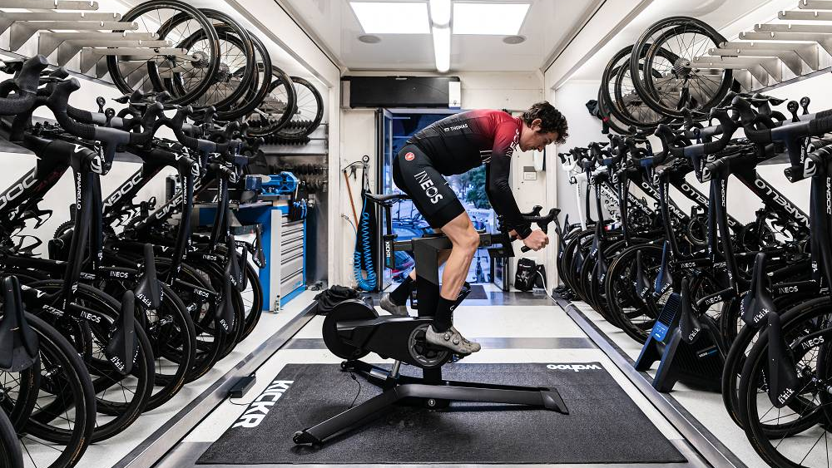
“Building the Better Athlete
in All of Us”
– Wahoo Fitness Mission Statement
Notes:
Anna

Slide 11
APPENDIX
Notes:
Anna

Slide 12
Appendix
MAR 653 - Homework 1
October 23, 2023
Group 1
Anna Khairi
Logan Roach
Mark Stiles
Oliver Gunn
Sachi Singh
Executive Summary
The data you analyzed: Customer data
The segments identified
3 segments (past time, health conscious, lifestyle)
A brief (bullet or two) description of the segment preferences and profiles
Segment 1 - athletic for pure pleasure (past time)
Segment 2 - like sports, care about their health and enjoy it (health conscious)
Segment 3 - athletic pure competition (lifestyle)
New products or features
Social Media Integration - sharable workouts, workout leaderboards between global users and friends
Nutrition Tracking - integrate with pre-existing companies (B-B engagement)
Product Warranties/ Insurance
Product Customization - Watch bands and faces, custom colorization
Growth strategies
More subscriptions- converting free app users to subscription app users
App Advertising (Search Prioritization)
More purchases per person
New products
Software Environment Creation - take Wahoo’s pre-existing software and integrate into one dashboard for customer ease of use but also advertise the subscription service and other promotional events

Slide 13
Appendix
Analysis
K-means
Developing an elbow plot with the data provided showed that three clusters provided value but a fourth cluster may also have provided additional value. We used the 3 clusters that were determined for us throughout the rest of the analysis but found it interesting to note.
Psychographics
Based on the answers to questions 1 and 2 provided there was a fairly clear delineation between the three segments. There were some minor overlaps between segments but it didn’t affect the overall analysis.
The first segment identified was as interested in being active as the other segments but with a higher focus on enjoyment and social engagement. They were also willing to spend more for a product they liked.
Segment 3 focused more on nutrition, performance and competitions. They would be more likely to purchase used or discounted products. They were more interested in maximizing the use of a product.
The second segment was in between the other two segments with a stronger lean towards performance but interest in enjoyment. There were less specific with their goals but were engaged in tracking and following sporting events.
The graphs show a visual representation of the answers above with visible differences between the clusters for most of the answers. They had a similar trajectory which confirms the result of the table.

Slide 14
Appendix
Demographics
The segments did vary by age and gender but not enough that it would be a determining factor in segmentation outreach. The ages for segment 1 and 2 were within a half a year of each other where segment 3 was around 2 years younger. Enough to say that a slightly younger age band was more active and focused on performance but not such a difference in age that it would logically make sense to target that age. Their age could indicate they have more disposable income. It could also mean there’s room to grow in the 20’s age range.
Gender was similar in that the difference between each group wasn’t leaning heavily toward one gender or another but all groups did lean slightly more toward 1 (men) than 2 (women).
Taking a look at the age distributions, there’s likely a big opportunity for outreach to the 20-35 age range that could be future customers. They’re not engaged in large numbers and should be considered for early outreach if the prime customer age is roughly 45. Preparing them to join early could improve overall customer lifetime value.
Fitness Preferences
All segments owned similar monitoring accessories. All segments were using tracking products like GPS and heart monitors. They connected devices with their phones which were mostly iPhones but also not insignificant numbers of Android users. No segment used recovery trackers in significant numbers or devices without tracking. Tracking was essential to them all.
All segments had similar exercise products. High percentages of all segments used the bike trainer and treadmill. There were noticeable levels of use for the rower, spin bike with or without screens, rowers, ellipticals, or smart bikes. No segment used the stair steppers in significant numbers. Overall all groups were heavy users of running or biking equipment. There wasn’t much difference between the segments except for treadmill usage. Segment 2 used the treadmill and rower at the highest rate but still within a narrow range of difference.
The athletic activities had some mixed results for the segments. Some activities had nearly the same activity level between segments and some had wide ranges between segments. Similar to the previous question, cycling, track running, all activities together and using an indoor trainer had consistently high levels in all segments. Running, triathlons and GPS use was significant but had gradations between the segments. Segment 1 had the least use of those and segment 3 had the highest which is consistent with the other findings that segments 3 had a higher commitment to competition and performance.
By utilizing get_top_correlations, create_coor_heatmap, cor functions, coorplot, and sorting in R. The top 20 positive correlations within each cluster were produced along with a heat map. This is an important step to figure out what is really going on within each cluster and to understand the difference amongst each cluster. By utilizing cluster specific insights marketing campaigns can be super specific towards each cluster to maintain a healthy retention rate.
Cluster 1 Q2_9 (Enjoy watching sports on TV) & Q2_10 (Enjoy going to live sporting events): Correlation 0.559 People who enjoy watching sports on TV are also likely to enjoy attending live sporting events. Q2_4 (Follow a structured training plan) & Q2_7 (Set specific performance goals): Correlation 0.480 Those who follow a structured training plan tend to also set specific performance goals suggesting a more disciplined approach to their sport or activity. Q2_2 (Knowledge about sporting equipment) & Q2_5 (Track and use data to measure performance): Correlation 0.383 Individuals knowledgeable about their sporting equipment also tend to track and use data to measure their performance indicating a technical and informed approach to their sport or activity.
Cluster 2 Q2_9 (Enjoy watching sports on TV) & Q2_10 (Enjoy going to live sporting events): Correlation 0.443 Similar to Cluster 1, individuals enjoying watching sports on TV also tend to enjoy attending live sporting events, but the correlation is slightly less strong in this cluster. Q2_2 (Knowledge about sporting equipment) & Q2_3 (Maintain own sporting equipment): Correlation 0.388 People who know a lot about their sporting equipment also tend to maintain their own equipment indicating a hands-on approach and deep engagement with their sport or activity.
Cluster 3 Q2_9 (Enjoy watching sports on TV) & Q2_10 (Enjoy going to live sporting events): Correlation 0.637 This correlation is the strongest across all clusters, enjoyment of watching sports on TV and attending live events goes hand in hand. Q2_5 (Track and use data to measure performance) & Q2_7 (Set specific performance goals): Correlation 0.442.

Slide 15
Appendix
Intuition of Wahoo and Growth Strategy
Wahoo stated that they found their growth areas were spinning, running and new products or features for existing customers and the data is consistent with these assumptions. They also consider their customers to be the ‘tip of the spear’. One aspect of the results counter that assumption and indicate there are other growth segments they could focus on.
Cycling and cyclists make up a large majority of all segments and most use spin bikes without a screen. It might be that they don’t find them necessary or it might be a growth market. A gap in content could explain why those numbers are that low. Targeted content and screen accessories may increase the likelihood of use of those products and offer more paying membership service opportunities. The unexpected results of the survey indicate that segment 1 and 2 are less focused on pure performance and could overlap with Peloton’s core customer base of health and fitness users. Segment 3 does match most closely to their expectation of users who are preparing for the next race. Providing a space for less performance focused users wouldn’t damage their brand if they continued to maintain a strong offering for the core customer base training focused users. Even users who train professionally have recovery days.
The running segment is certainly a growth opportunity. Many of the customers are also runners. They would find value in more devices like watches, rings and smart clothes. Marketing targeted towards runners would be worth pursuing to grow that segment. More specific metrics toward running would also make sense to engage with them more precisely. The differentiation between the other brands could be treadmills that integrate better with devices and blend the overall user performance into a cohesive narrative of their growth. The Wahoo brand is known for high performance users and should use that credibility to win head to head with their competitors.
Existing customers don’t have a lot of gaps in product ownership to fill. All segments seem to favor similar products but it might be useful to make more sense of the data for the user. Answering questions like ‘Is diet or sleep affecting their performance?’ or ‘Which balance of workout and recovery days provide the best overall performance?’ could be valuable to engage users longer and identify which other data points to incorporate. SYSTM/Sufferfest training provides a lot of value for those focused on competitions but content could branch out to allow for other types of workouts similar to Peloton offering cool downs or supplemental stretching videos. Updated products with combined features like watches, heart rate monitors and gps products are often used and would continue to be a source of revenue. The bike trainer is the most used product by all segments and integrated accessories for it should be a primary area of expansion.

Slide 16
Appendix
Product and Feature Recommendations
We have identified and named three target segments: Past Time, Health Conscious, Lifestyle. Recommendations will be for each segment specifically.Past Time
High Quality Features
Social Perks
Social Media Integration - Sharing Apps
Focused dashboard tools
From the average responses to survey questions, individuals in Cluster 1 engage in exercise more casually than those in other clusters where high quality features and structured workouts could engage the customer to being a more committed user. Those in cluster 1 seemed to be lightly engaged in exercising while also using it as a leisure activity and a tool to destress. Incorporating a user-friendly dashboard with structured workouts, promotional campaigns, and the Wahoo software apps could introduce casual customers into using more apps and products such as the subscription based app. Social media integration into the dashboard would also allow those who use exercise as a leisure activity to connect with others with a similar mindset.
Health Conscious
More entertainment
Social perks
Food Recommendations
Individuals in Cluster 2 occupy customers who enjoy exercising more and appear to favor a health conscious lifestyle where features such as nutrition tracking would offer those who are already dedicated to exercising further incentives for using Wahoo apps and products. While customers in Cluster 2 would rather use exercise as an opportunity to destress, accolades and leaderboards for friends and global users could convert customers who already have a focus on healthy living into more dedicated customers as they use the social media capabilities to connect with friends and other similarly minded people. Additionally, partnering with a company with access to software that has nutrition recommendations and tracking capabilities would not only retain customers in Cluster 2 but also customers inclined with a more competitive mindset.
Lifestyle
Discounts - every one should be on your equipment
Product Feedback Portal
Community program - yearly mvp awards
Newsletter / Event Reminders - they want to be informed
Social Perks
Stylized / Personalized Apparel
Streaming Content
Recap Races
Special Destination Trails (Hillside, Cityscape, Woods)
Personal Goal Recap (like facebook memories)
From the survey data Cluster 3 customers seem to be more dedicated in tracking their exercise progress while being the most competitive segment of the surveyed customers. Customers in Cluster 3 would benefit the most with a dashboard with Wahoo apps and social media integration as these customers are the most incentivized to use the subscription based services and share exercise progress with friends and compete on leaderboards. Other features catered to Cluster 3 customers could include promotions, features, and events. Customers in cluster 3 are also prime targets for integrating into higher tiered subscriptions at a higher cost but with access to virtual and in person promotions, features, and events.

